Slide 1
DATA-380: Final Project Cost of Living in the US
By: Clark Metz

Slide 2
Dataset
Cost of Living in the USA
≈ 3100 data points
Looks at Income and Expenses
11 Quantitative Variables (next slide)
4 Categorical Variables (next slide)

Slide 3
Variables
Quantitative Variables | Categorical Variables
Num_adults | State
Num_children | Family_member_count
Total_cost | isMetro
Housing_cost | Region
Food_cost
Transportation_cost
Healthcare_cost
Childcare_cost
Taxes
Median_family_income
Total_family_members

Slide 4
Problem/ Objective
- Use the variables in the data to look for trends/patterns that affect cost of living from state to state
- Create different graphs and charts to visualize trends/patterns
- Bar Charts
- Choropleth Map
- Scatter Plots
- Bubble Plots

Slide 5
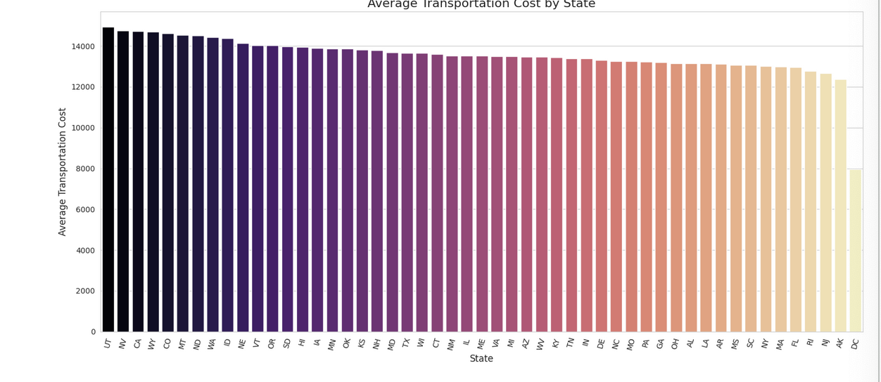
Transportation Cost by State
3 Most Expensive States: Utah, Nevada, California
3 Least Expensive: New Jersey, Arkansas, Washington DC

Slide 6
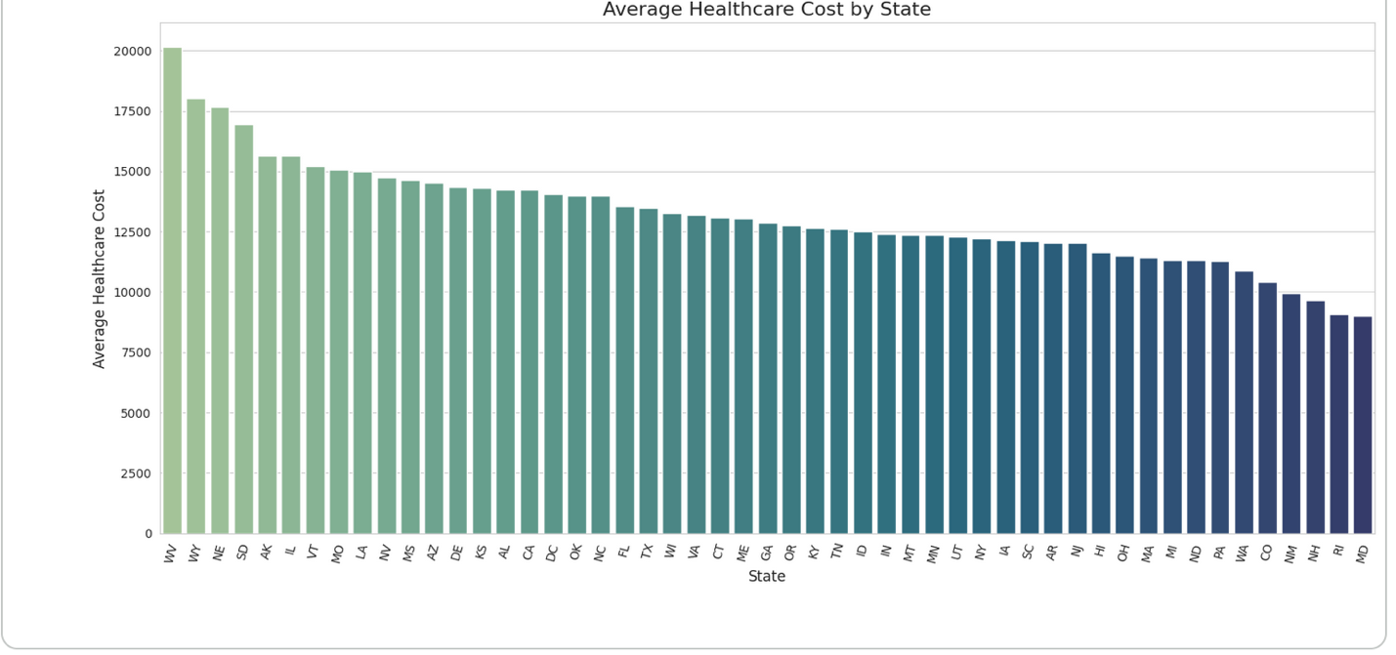
Healthcare Cost by State
3 Most Expensive States: West Virginia, Wyoming, and Nebraska
3 Least Expensive: New Hampshire, Rhode Island, and Maryland

Slide 7
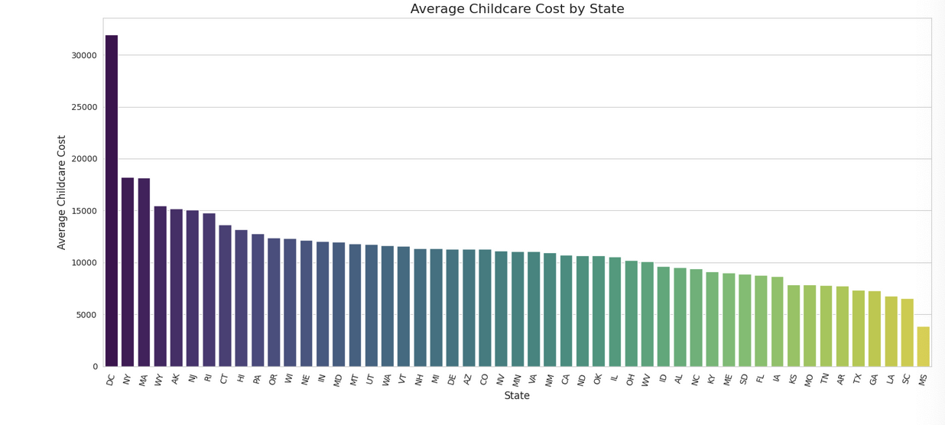
Childcare Cost by State
3 Most Expensive States: Washington DC, New York, Massachusetts
3 Least Expensive States: Louisiana, South Carolina, Mississippi

Slide 8
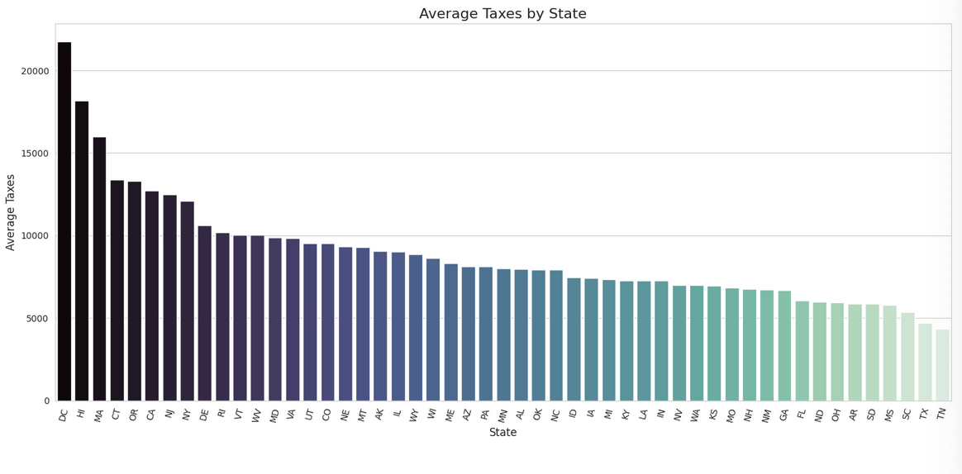
Taxes by State
3 Most Expensive States: Washington DC, Hawaii, Massachusetts
3 Least Expensive States: Tennessee, Texas, South Carolina

Slide 9
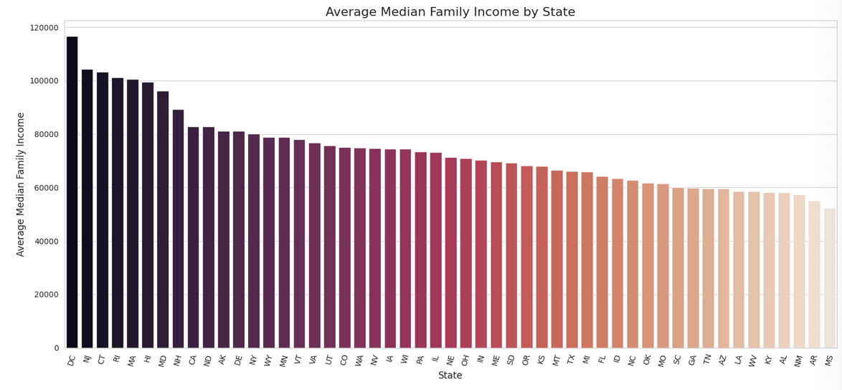
Average Median Family Income by State
3 Most Expensive States: Washington DC, New Jersey, Connecticut
3 Least Expensive States: New Mexico, Arizona, Mississippi

Slide 10
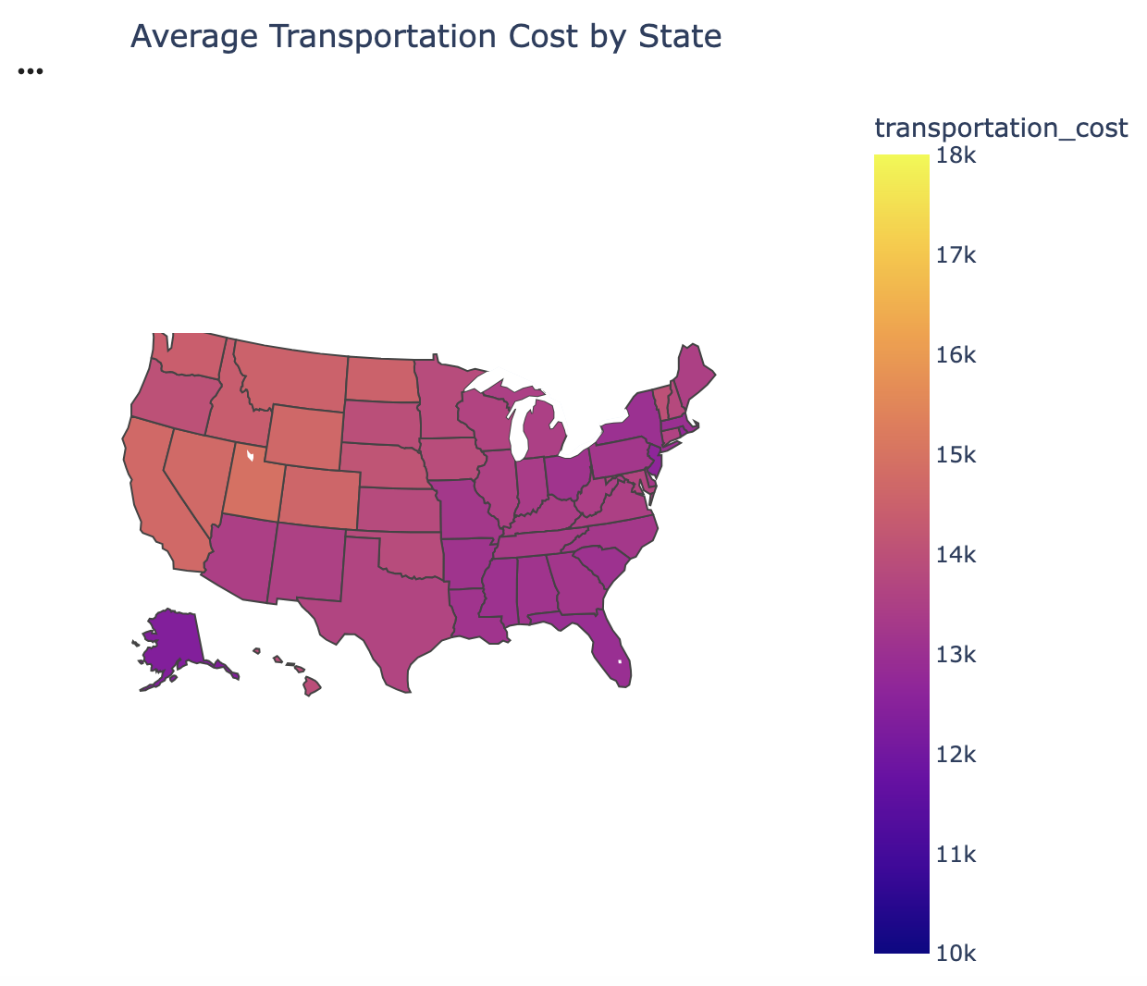
Transportation by State (Choropleth)

Slide 11
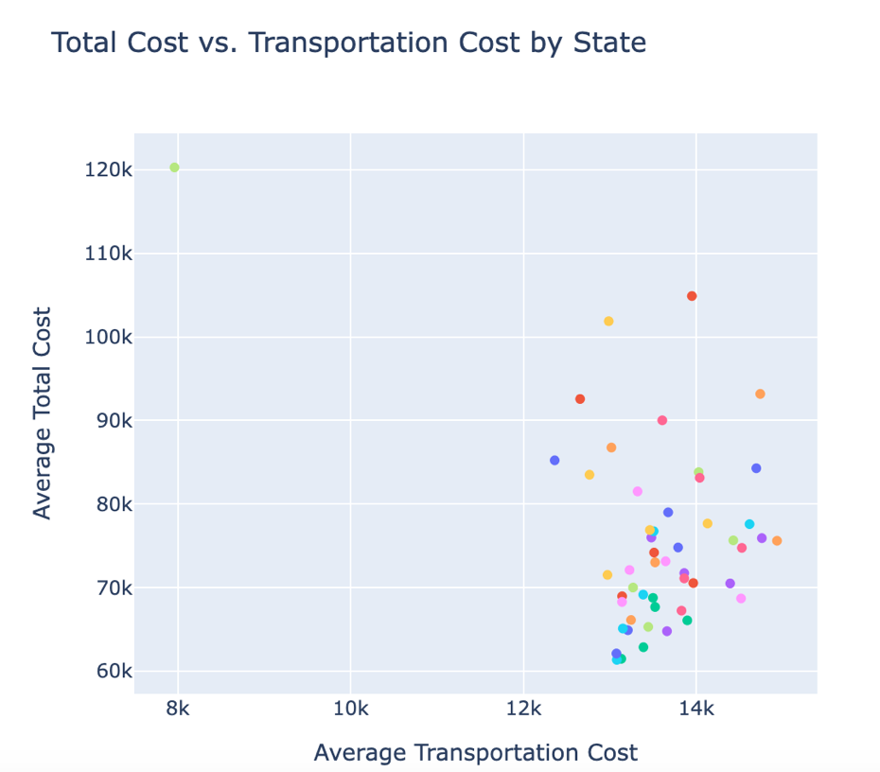
Total Cost vs. Transportation Cost by State
Notes:
Total Cost variable is calculated by taking the mean of the cost of living from each state
By comparing this to the transportation cost, we can look at the correlation and see how much of a contributing factor transportation is to the total cost of living
Washington DC is a clear outlier in the top left corner with the highest total cost but lowest transportation cost

Slide 12
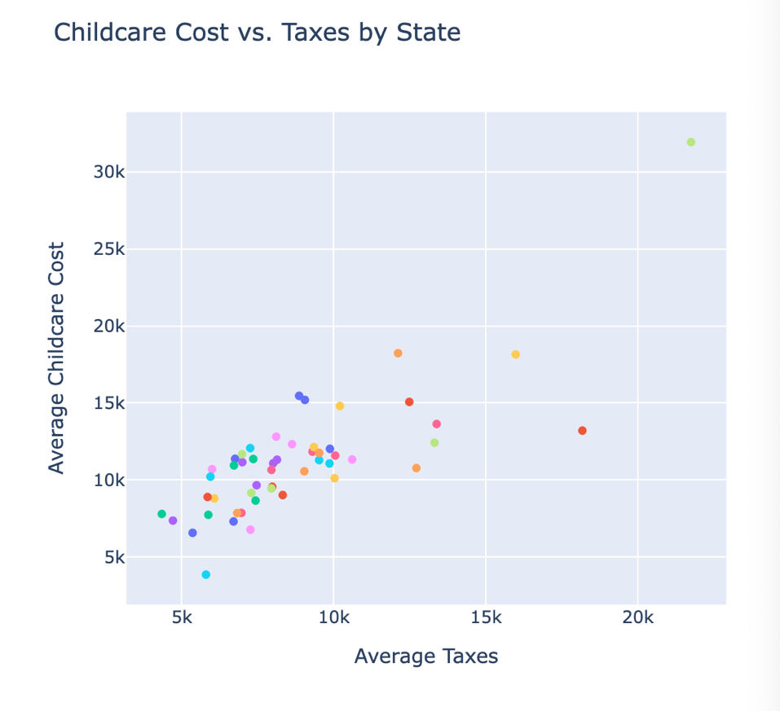
Childcare Cost vs. Taxes
Notes:
Strong Positive Correlation
States with higher taxes have a higher cost of childcare

Slide 13
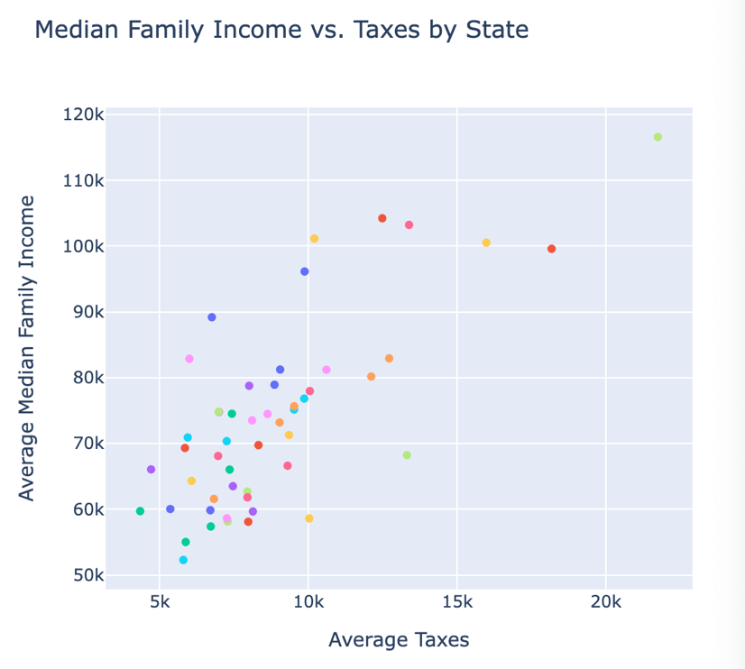
Median Family Income vs. Taxes
Notes:
Strong Positive Correlation
More money you make, the more taxes you pay
DC has the highest income and taxes, similar states have highest of both

Slide 14
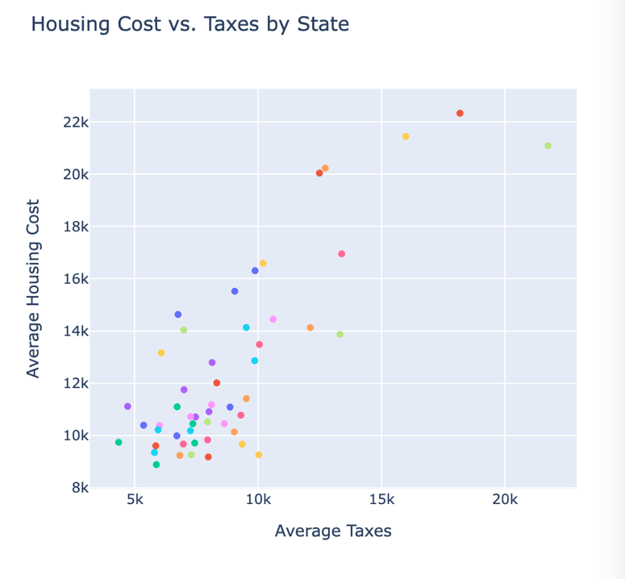
Housing Cost vs Taxes
Notes:
Strong positive correlation
Graph shows that the more housing cost, the more taxes are paid

Slide 15
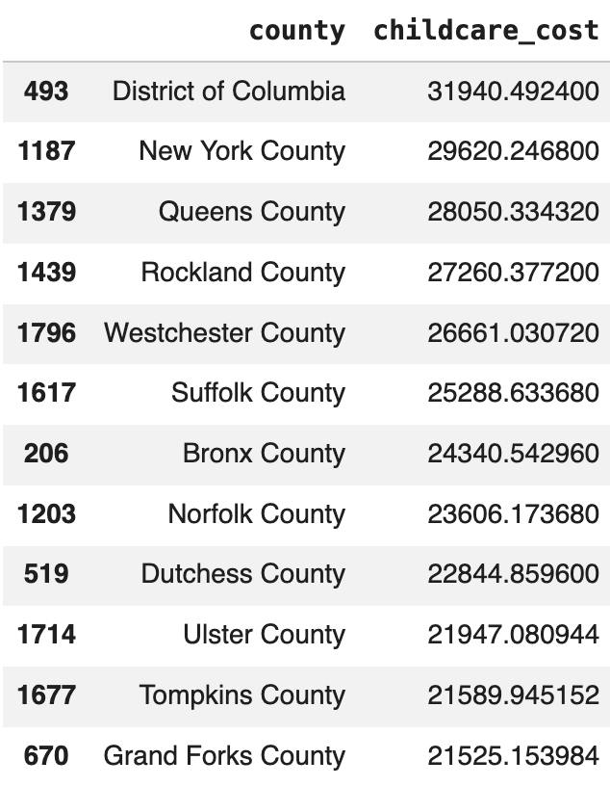
Most Expensive Counties for Childcare
Notes:
Other than District of Columbia, all other counties are in New York

Slide 16
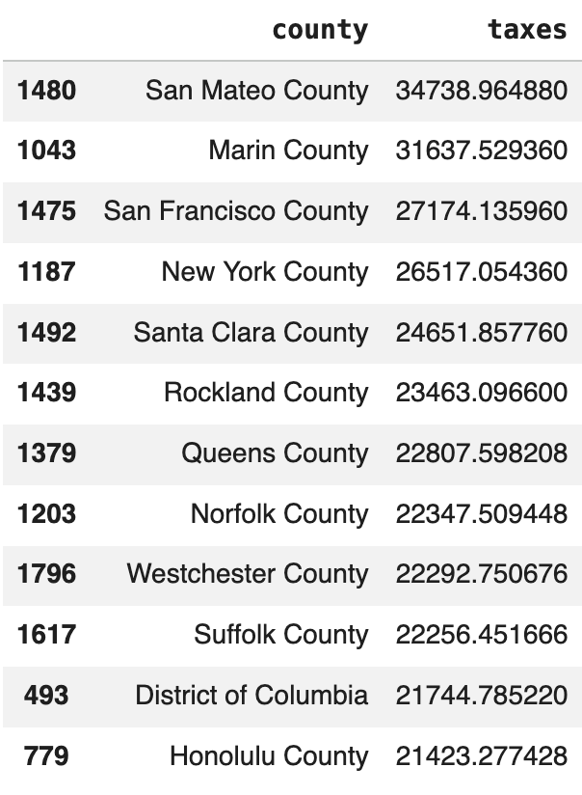
Most Expensive Counties for Taxes
Notes:
Other than Honolulu County, all counties on chart are either New York or California
Soe counties appear on both charts, lines up with the correlation found between childcare cost and taxes

Slide 17
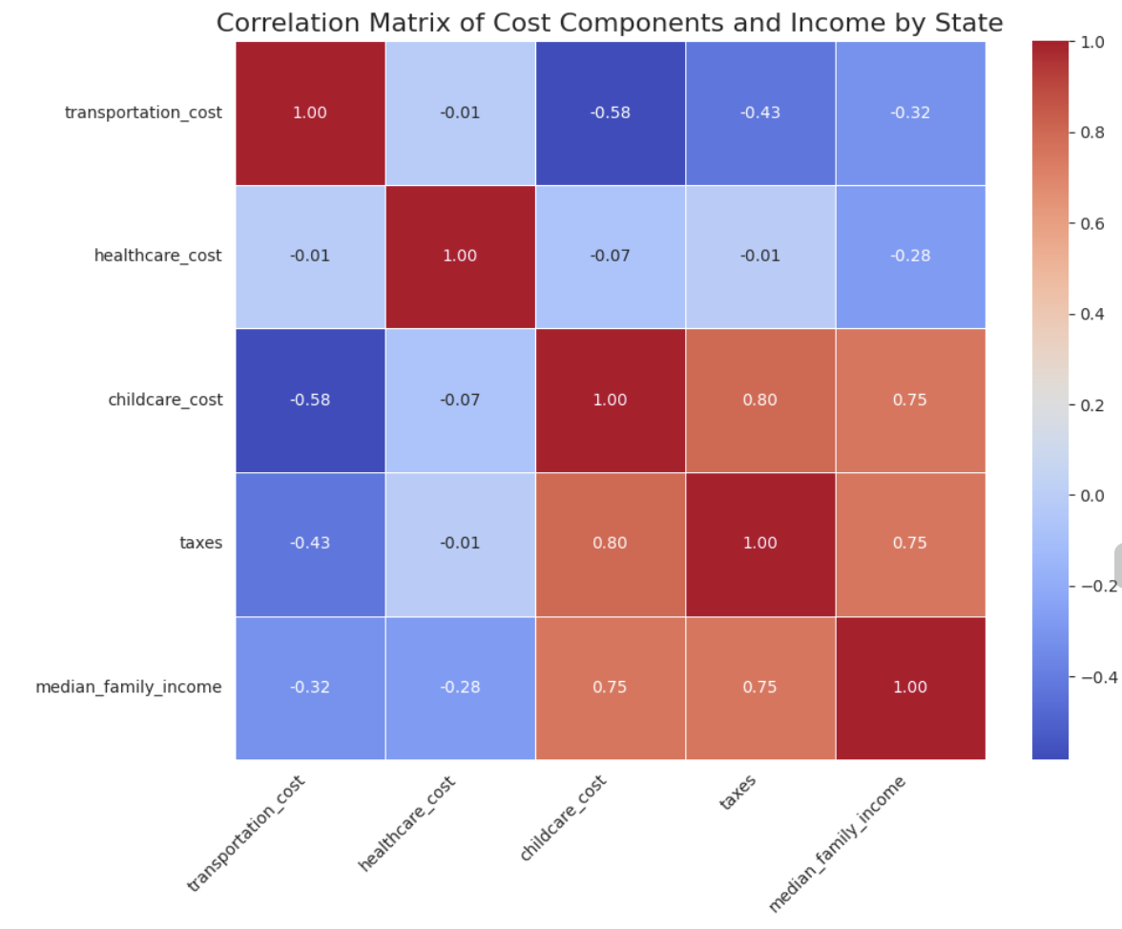
Correlation Matrix (Quantitative Variables)
Notes:
Family income and childcare cost and taxes have the strongest correlation
Helps easily pickout which variabels have strong and weak correaltions

Slide 18
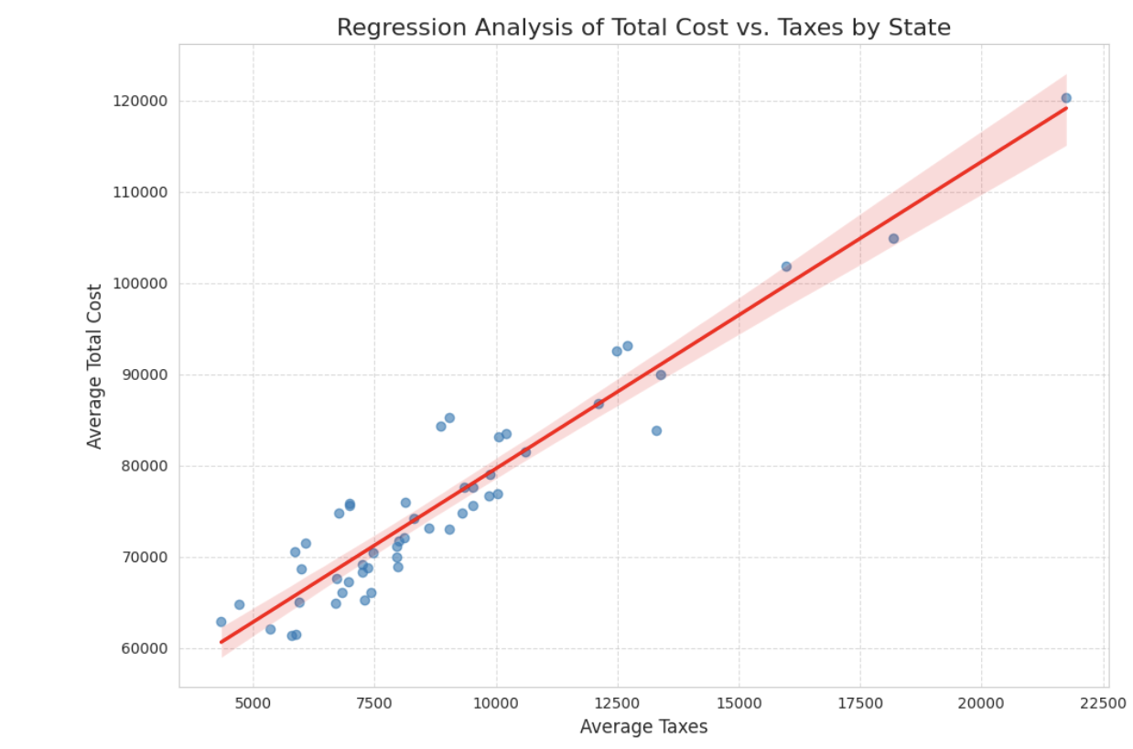
Total Cost vs Taxes
Notes:
Shows very clear strong positive correlation between total cost and taxes
Tells us that taxes are a strong contributor to the total cost of living in the US

Slide 19
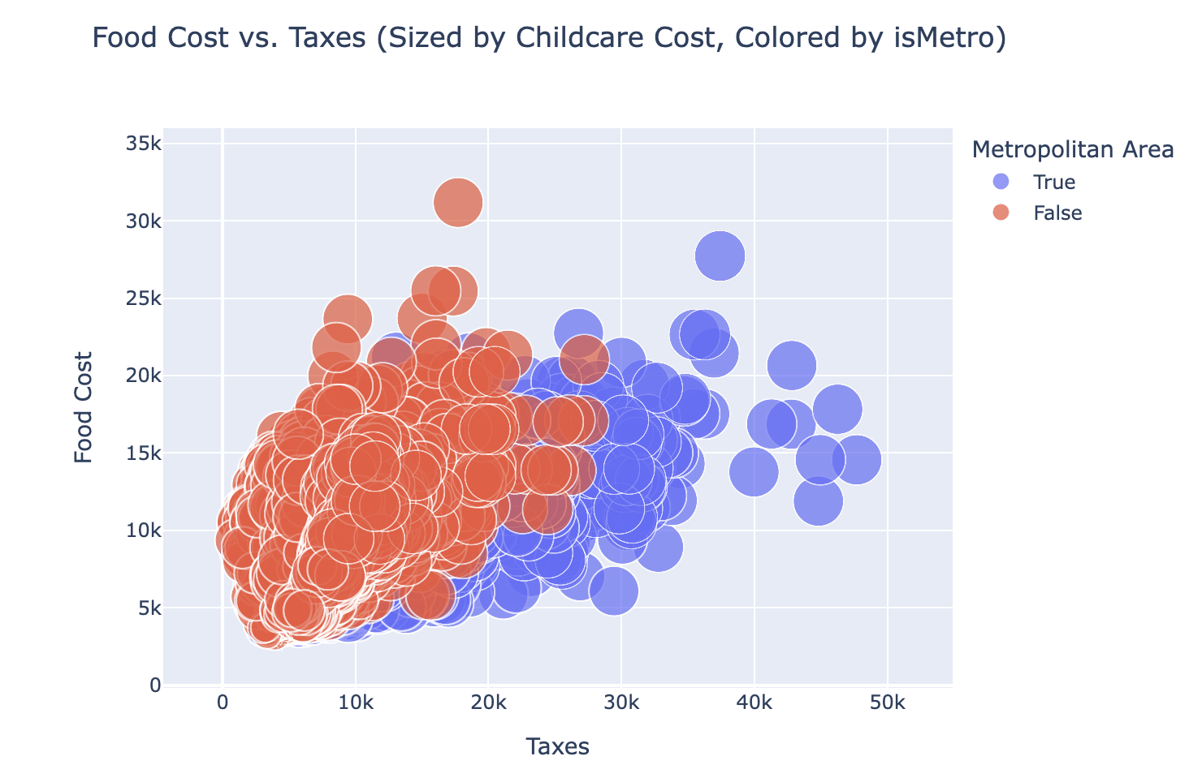
Food Cost vs Taxes (Colored by isMetro)
Notes:
Shows not much of a correlation between food cost and taxes
But can see through the coloration of the bubbles that the states that are metro have higher taxes

Slide 20
New Findings
-
Taxes have the most impact on the total cost of living
Washington DC stands out as having the highest average income but also the highest cost of living
Transportation cost goes up farther east in the US

Slide 21
Conclusion
-
Several factors affect the cost of living in the US
Varies state by state
Can’t narrow down the cost of living to one variable
Numerous outside factors that can not be quantified that affect cost of living

